Slide 1
Network Layer

Slide 2
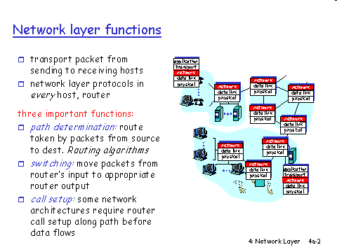

Slide 3
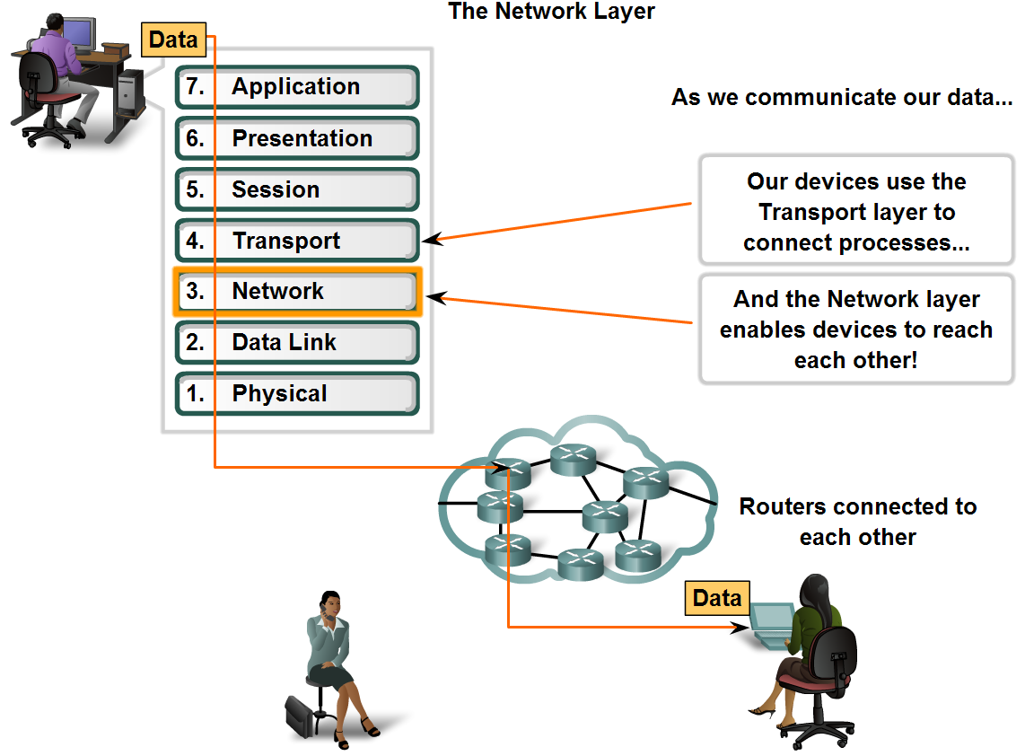
Network Layer in data networks

Slide 4
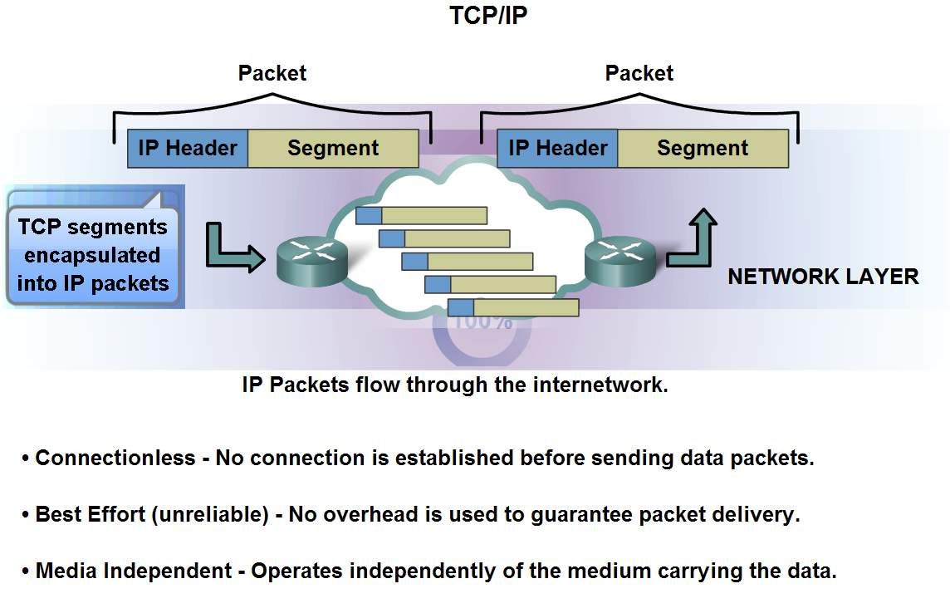
The best-known example of a layer 3 protocol is the Internet Protocol (IP).
It manages the connectionless transfer of data one hop at a time,
Basic characteristics and the role of the IPv4 protocol

Slide 5
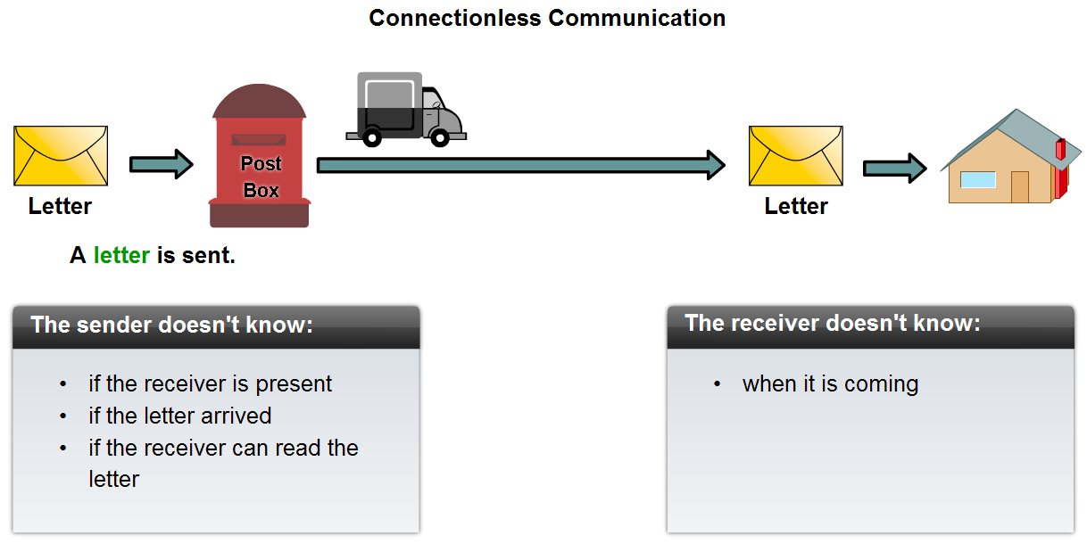
Connectionless – IP Protocol

Slide 6
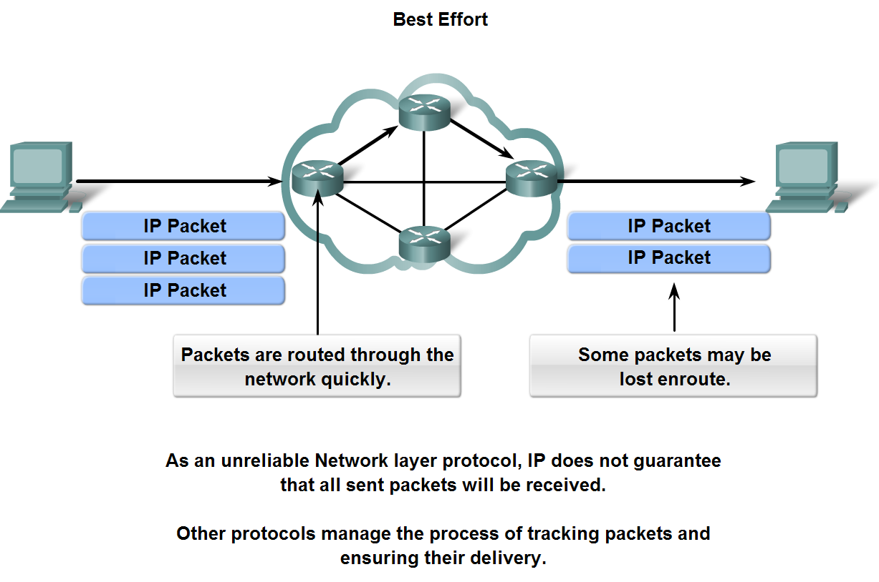
IP - Unreliable protocol

Slide 7
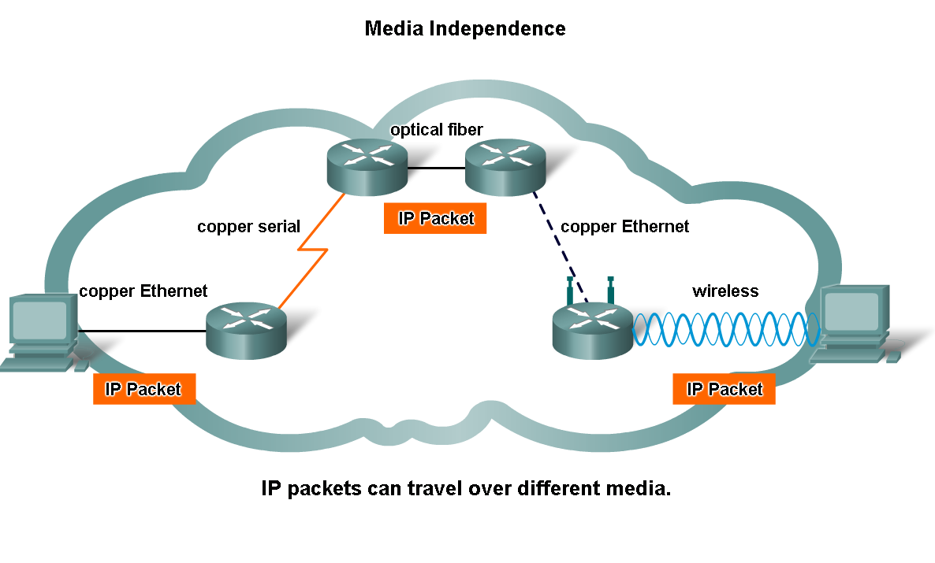
IP - Media independent

Slide 8
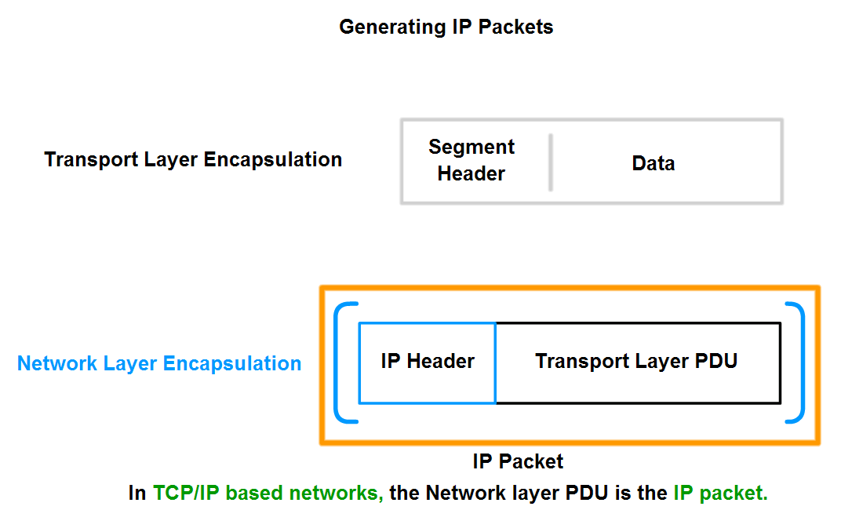
Packets

